Slide 1
PHYSIC INFORMED NEURAL NETWORK
Overview

Slide 2
TOPIK #1 SOLAR PANEL
Overview

Slide 3
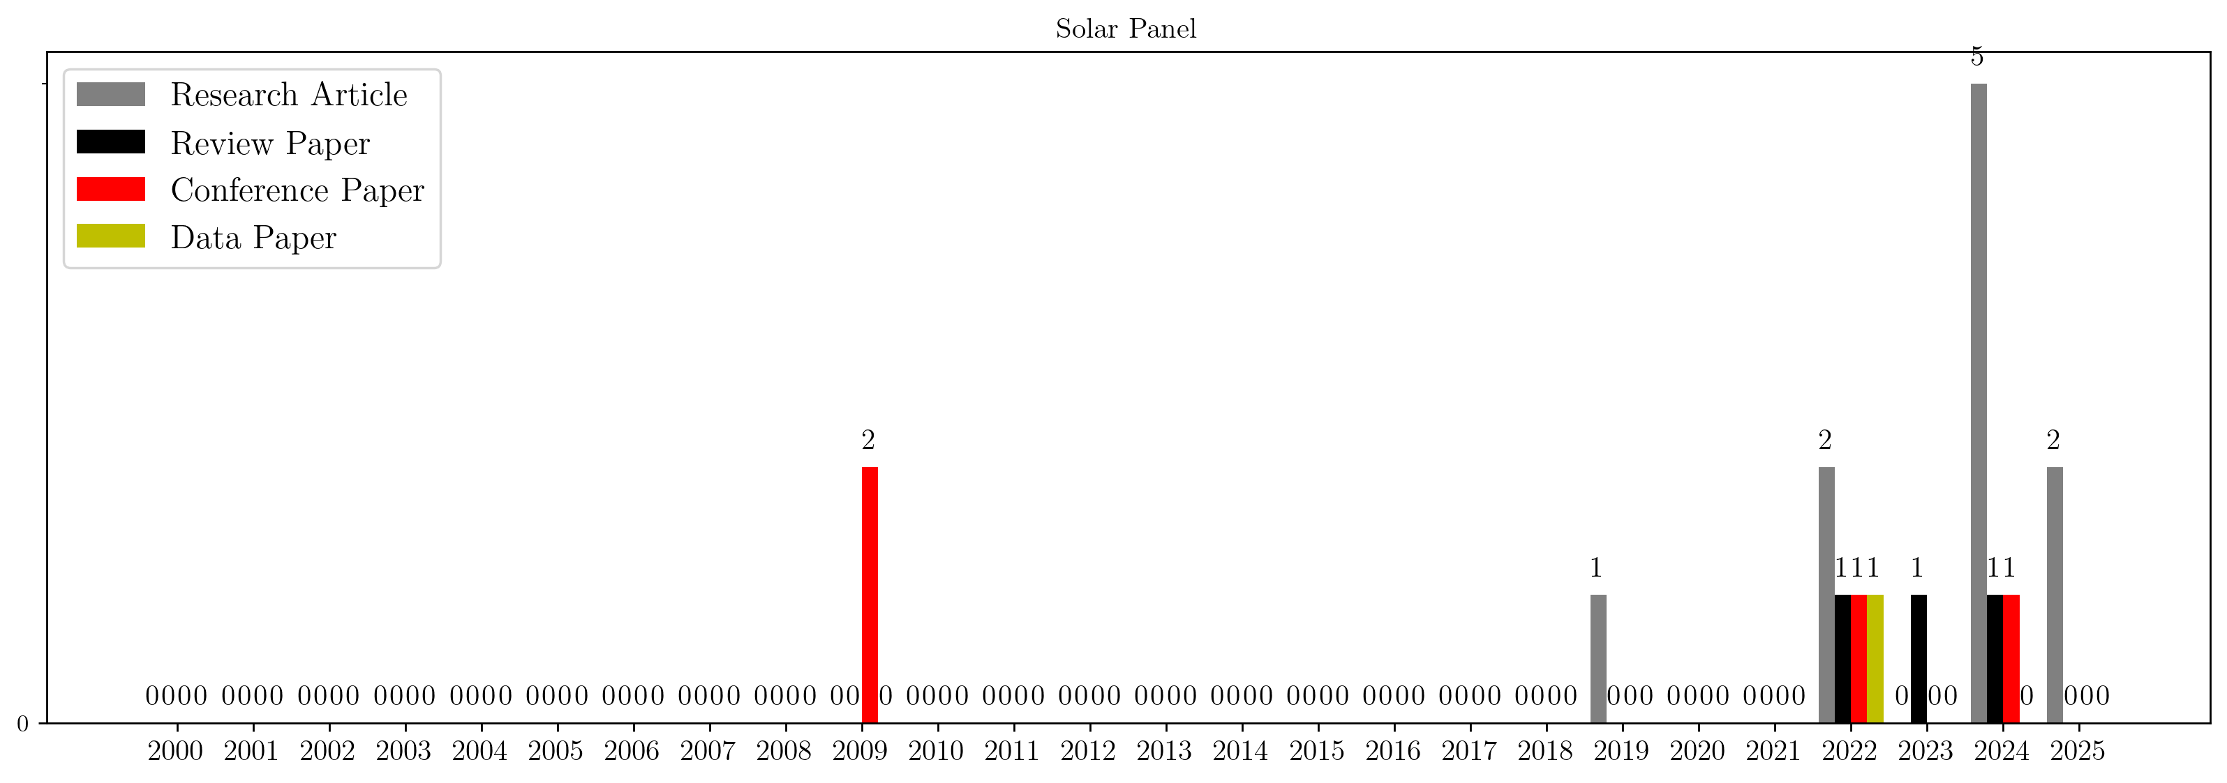
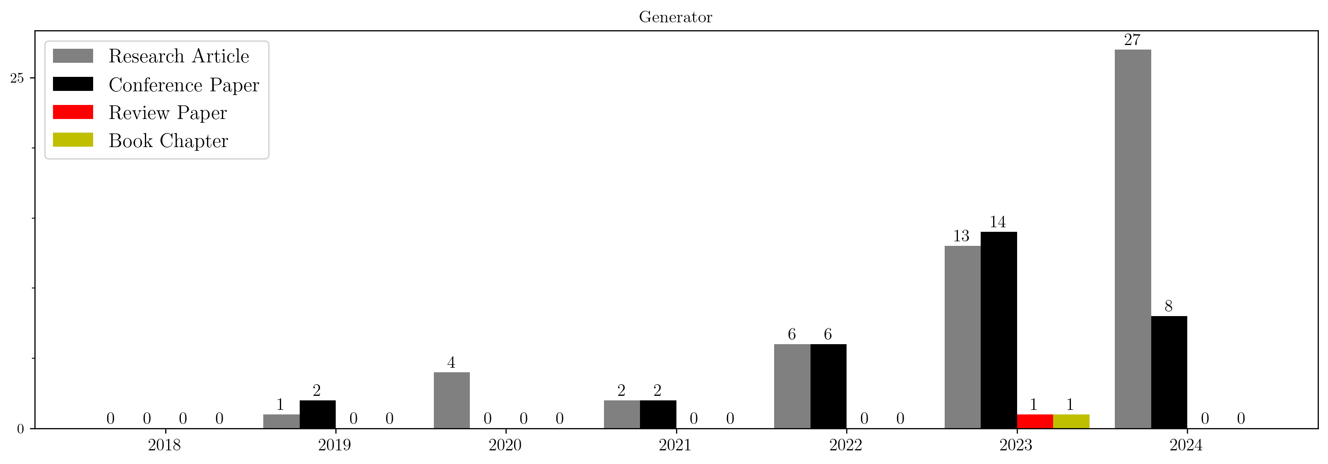
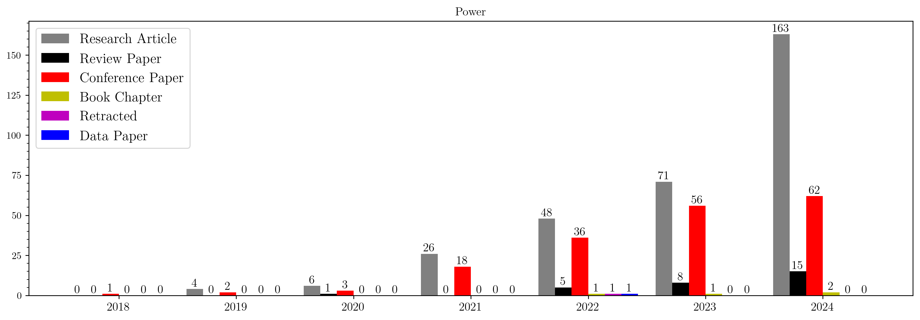
SHALLOW LITERATURE STUDY
In order to find the novelty behind the topic, study literature analysis was conducted using PRISMA framework using these three search queries as follows:
“physic-informed” AND “power”
“physic-informed” AND “generator”
“physic-informed” AND (“solar panel” OR “photovoltaic”)
This study literature is relatively shallow since the analysis was carried out by using Scopus as the only source. Using this approach:
573 papers successfully gathered and 544 papers are filtered from the query number one.
104 papers successfully gathered and 88 papers are filtered from the query number two.
28 papers successfully gathered and 18 papers are filtered from the query number three.

Slide 4
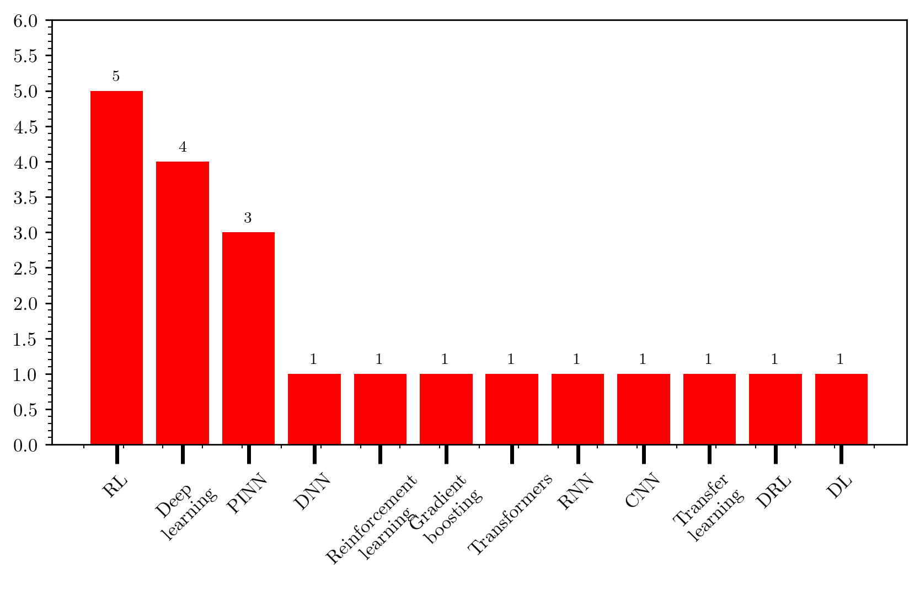
TOPIK PENELITIAN
The result of this analysis, shows that in the topic of solar panel, the research is more focus on reinforcement learning field. The filtered paper are studied manually, with the discussion as follows:
The topic is too technical and specific
The topic is too focus on the modelling of the environment and the agent
The model constraint or boundary is too simple

Slide 5
TOPIK #2 ACOUSTIC WAVE
Overview

Slide 6
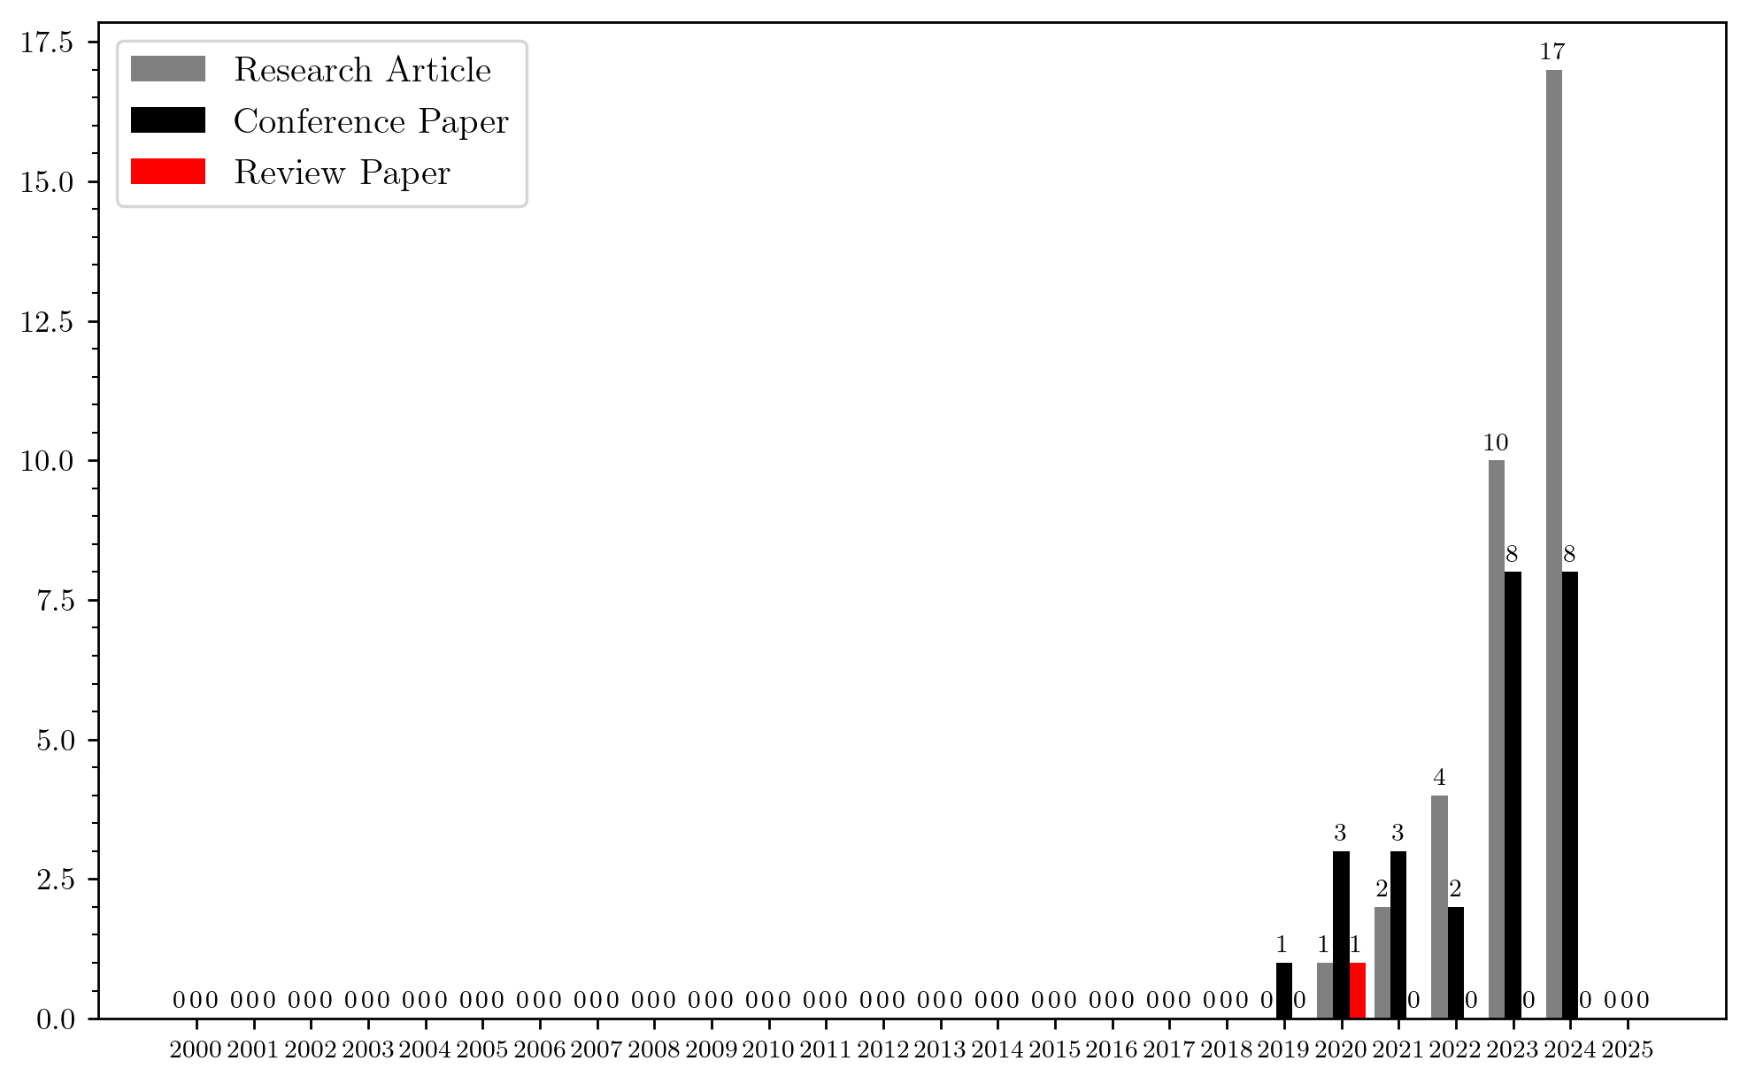
SHALLOW LITERATURE STUDY
In order to find the novelty behind the topic, study literature analysis was conducted using PRISMA framework using these three search queries as follows:
“physic-informed” AND “acoustic wave”
This study literature is relatively shallow since the analysis was carried out by using Scopus as the only source. Using this approach:
64 papers successfully gathered and 60 papers are filtered from the query

Slide 7
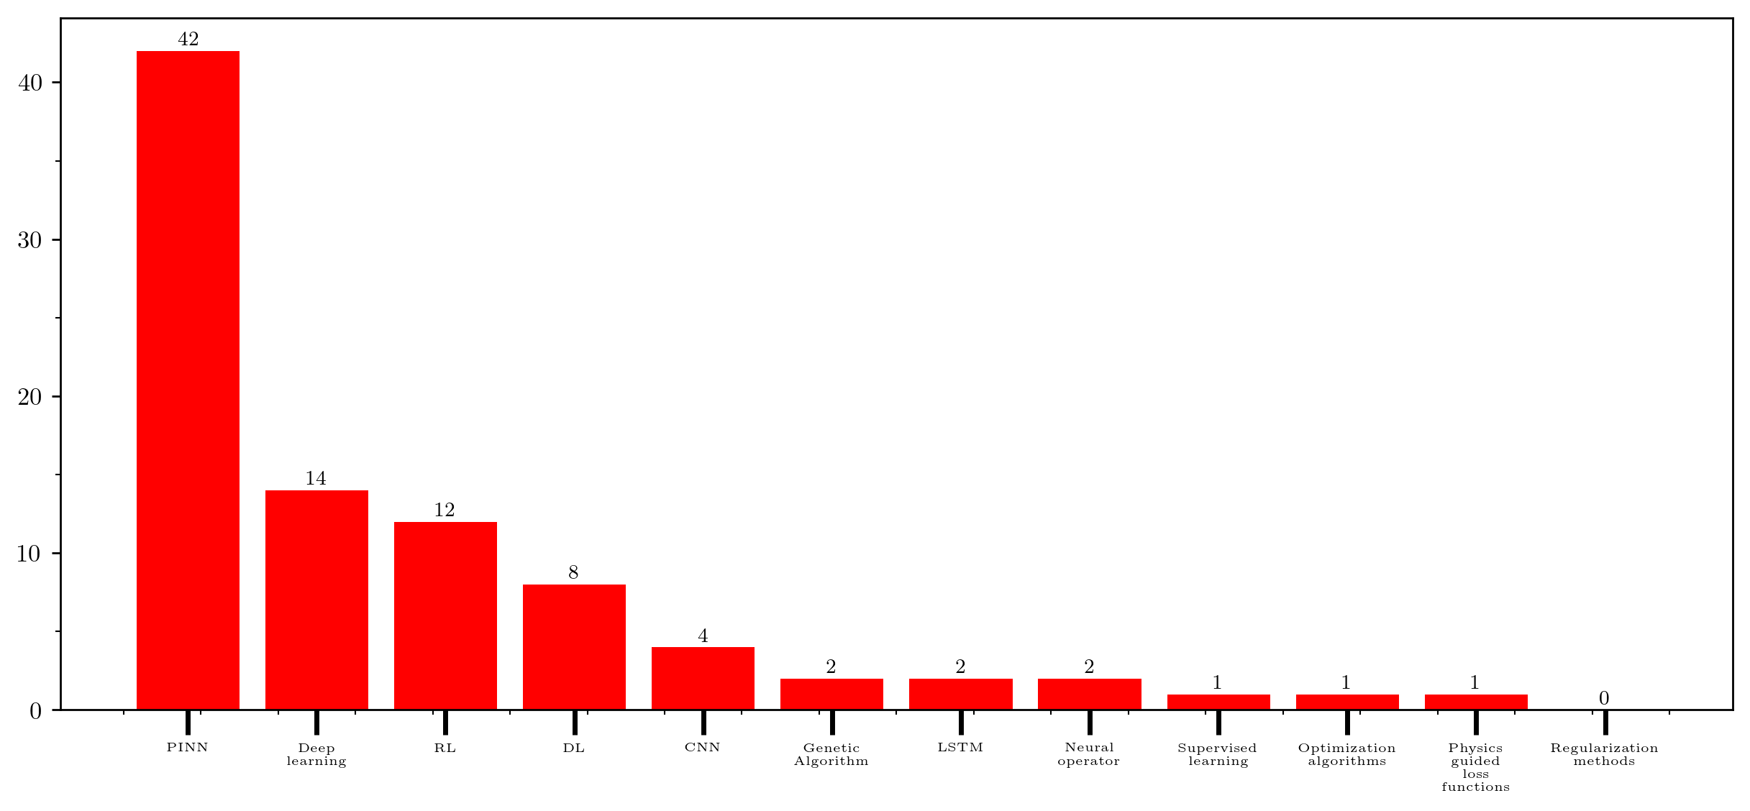
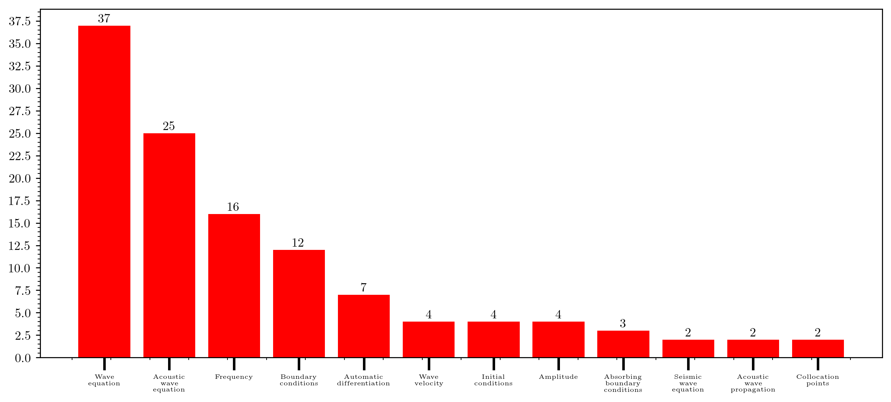
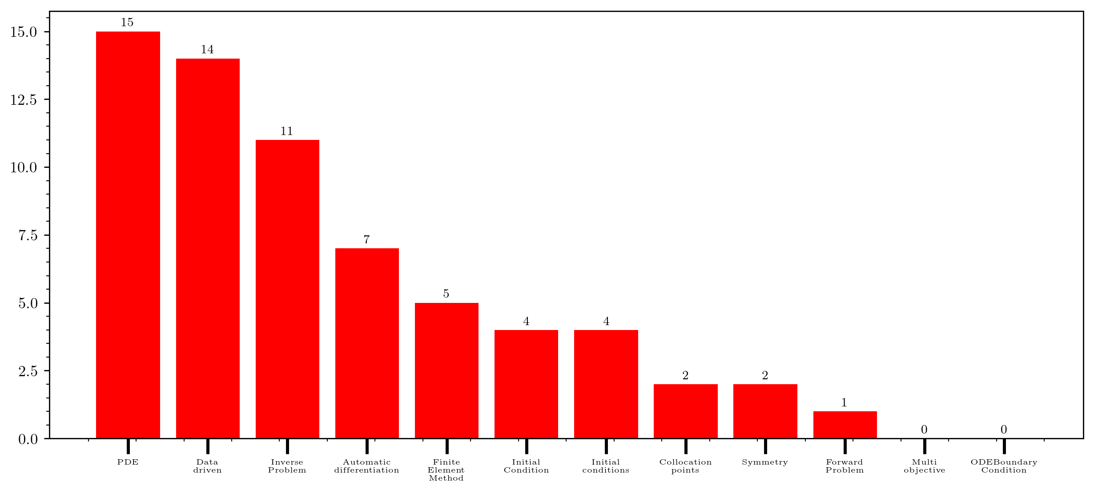
TOPIK PENELITIAN
Machine Learning Perspective
Field Perspective
Mathematical Perspective
The result of this analysis, shows that in the topic of wave equation is relatively few, with most of the research is more focus on bio-medical and acoustic wave for communication.

Slide 8
RESEARCH FLOW
Literature review
Exploring Machine Learning Approaches for Solving Wave Equations: A Review, Trends and Challenges”
Supervised Learning Approach
Physics-informed neural networks: A deep learning framework for solving forward and inverse problems involving nonlinear partial differential equations (Forward & Inverse Problem)
Multi-Objective Loss Balancing for Physics-Informed Deep Learning (Multi-Objective Loss)
Solving the wave equation with physics-informed deep learning (Convolutional)
Physics-informed graph convolutional neural network for modeling geometry-adaptive steady-state natural convection (Mesh)

Slide 9
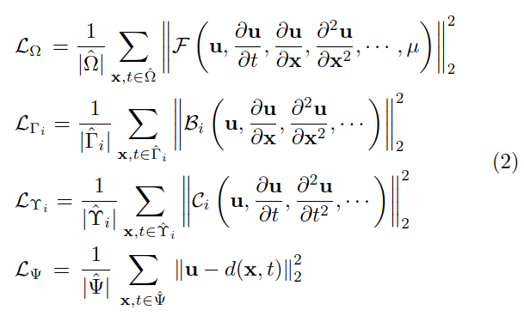
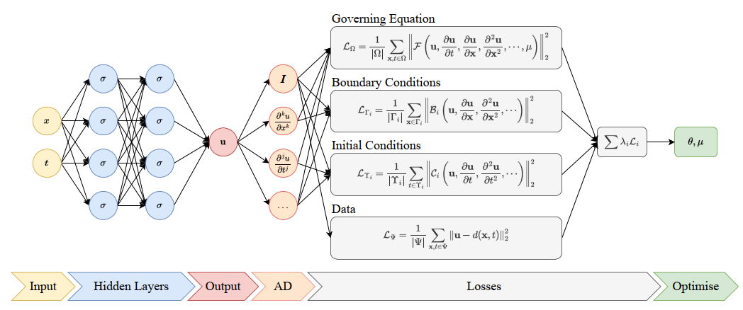
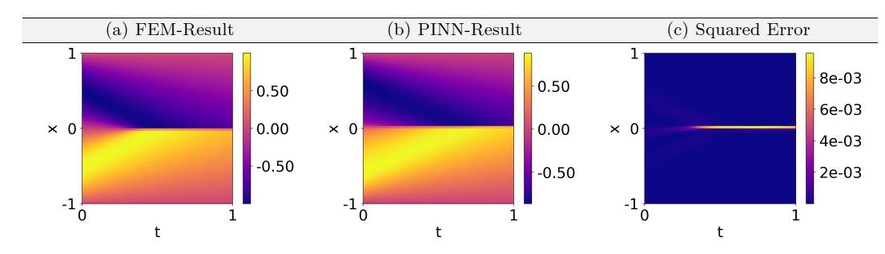
CASE STUDY: INCOMPRESSIBLE FLOWS
Cai, Shengze, et al. "Physics-informed neural networks (PINNs) for fluid mechanics: A review." Acta Mechanica Sinica 37.12 (2021): 1727-1738.

Slide 10
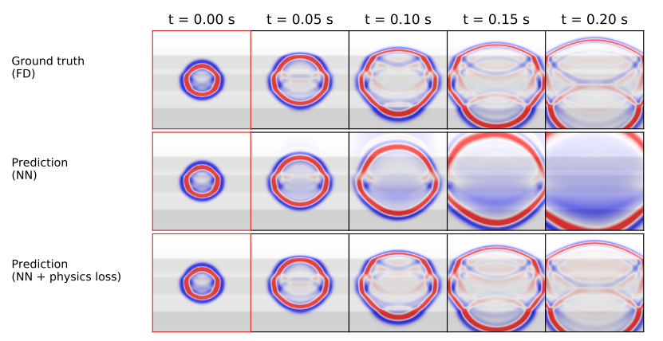
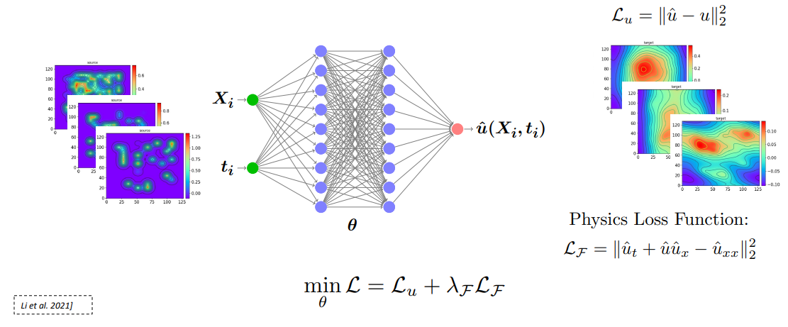
PHYSIC-INFORMED NEURAL NETWORK
Collecting a large number of data through simulation and then feed it into Neural Network model while adding PDE constraint/condition in architecture

Slide 11
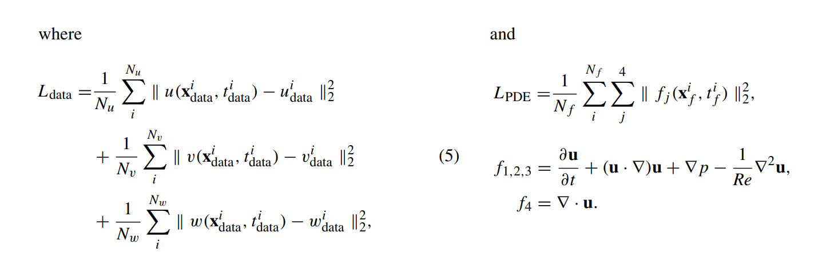
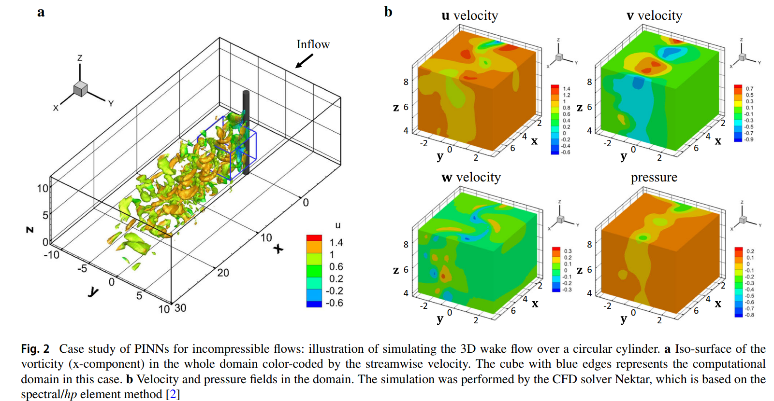
CASE STUDY: INCOMPRESSIBLE FLOWS
Cai, Shengze, et al. "Physics-informed neural networks (PINNs) for fluid mechanics: A review." Acta Mechanica Sinica 37.12 (2021): 1727-1738.

Slide 12
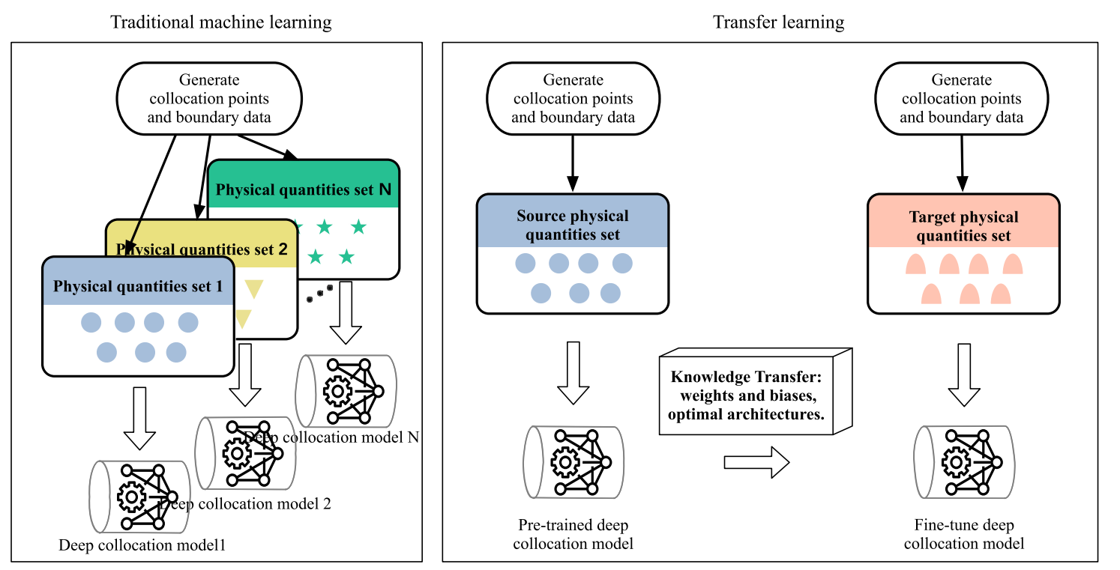
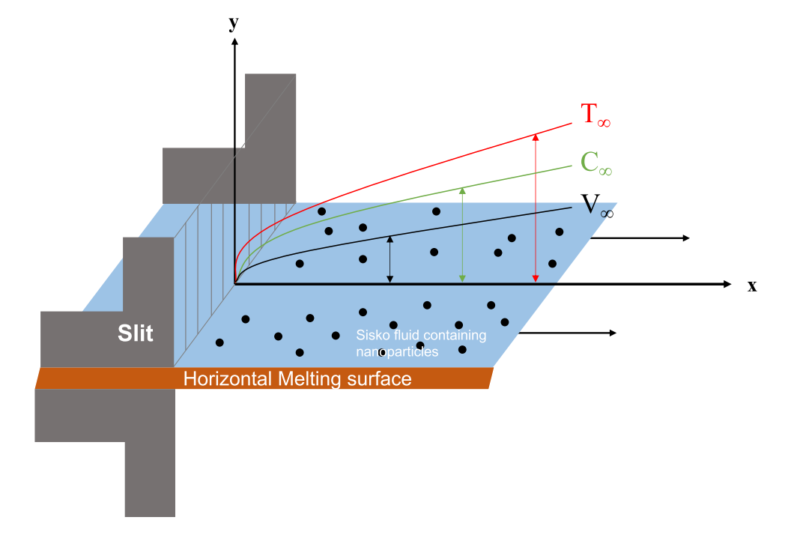
CASE STUDY: MELTING HEAT TRANSFER
Guo, Hongwei, et al. "Physics-informed deep learning for melting heat transfer analysis with model-based transfer learning." Computers & Mathematics with Applications 143 (2023): 303-317.

Slide 13
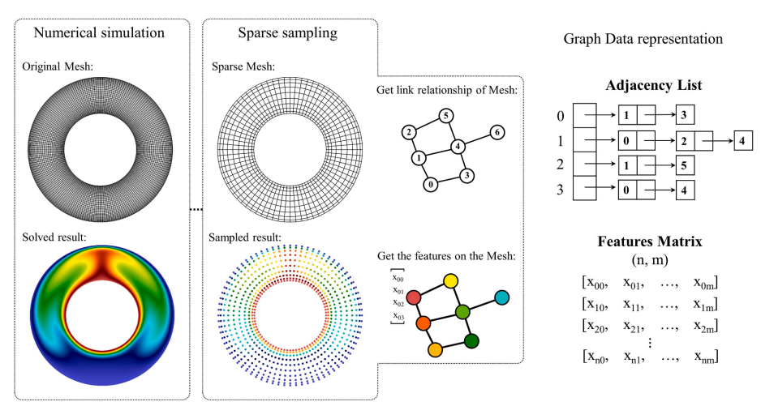
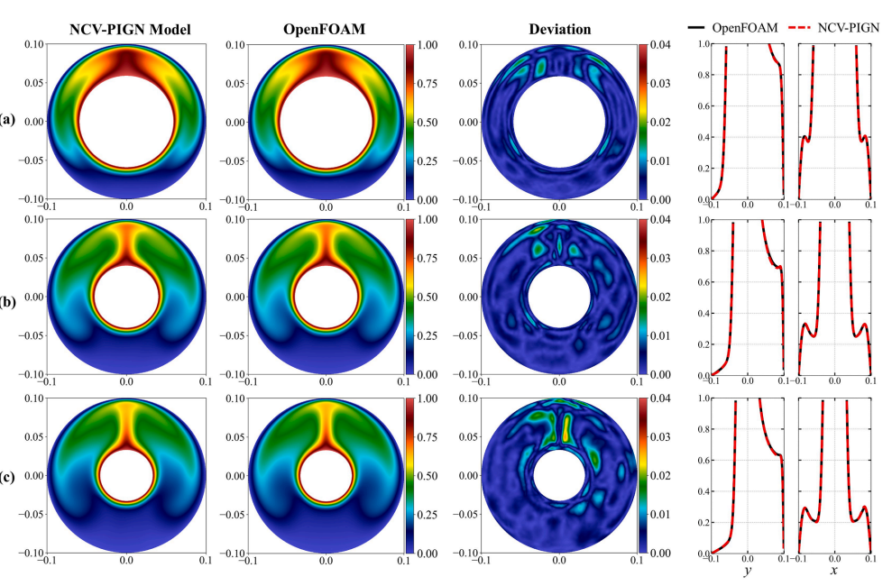
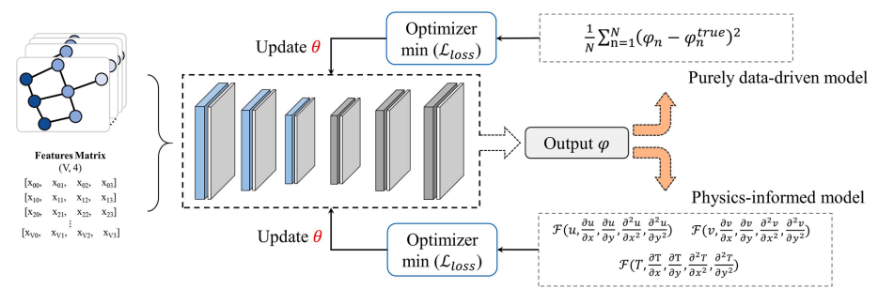
PHYSIC-INFORMED NEURAL NETWORK
Physics-informed graph convolutional neural network for modeling geometry-adaptive steady-state natural convection

Slide 14
PHYSIC INFORMED NEURAL NETWORK
Overview

Slide 15
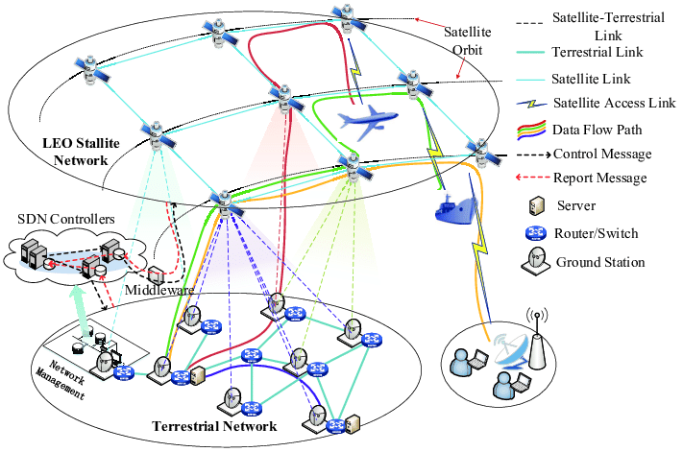
TOPIK PENELITIAN
Sensor nodes are resource-constrained devices in terms of communication range, computational ability, memory storage, and energy resources.
In order to address these limitations, various approaches have been attempted, such as :
Deployment strategies
Adaptive power control
Sleep-wake scheduling
Routing protocol

Slide 16
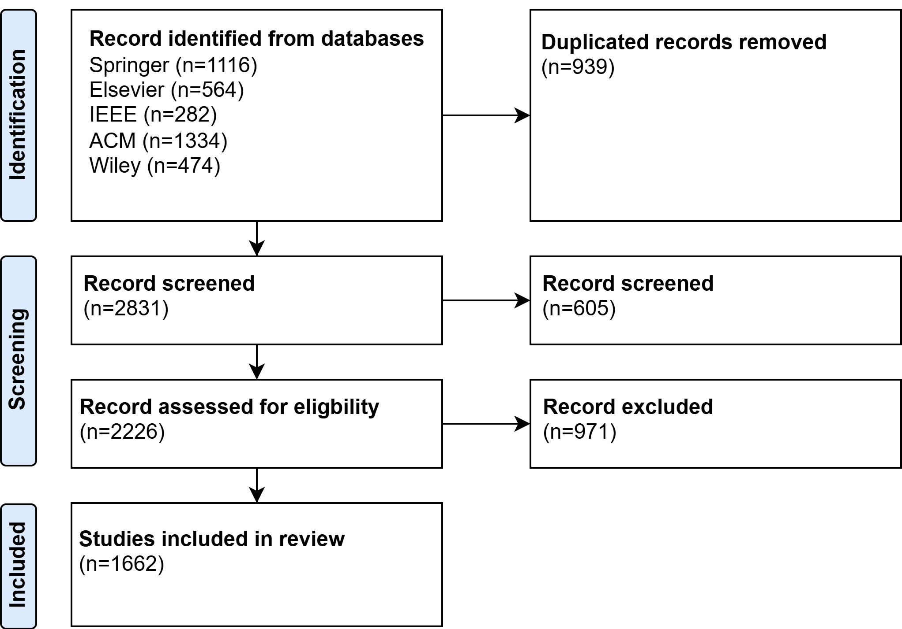
TOPIK PENELITIAN
Search query:
(“reinforcement learning” OR “RL”) AND (“protocol routing” OR “routing strategy” OR “routing algorithm”) AND (“Wireless Sensor Network” OR “WSN” OR “Sensor Network”) AND “energy”
Inclussion
The article is written in English and published between January 2019 and August 2024.
The article must be peer-reviewed and not a secondary manuscript like a survey, systematic review, mapping, or other types of reviews.
Filter process:
If there are the same articles in different publishers
If there is incomplete article information or incorrect parsing.
Articles that have been excluded and have four components of the properties specified in the title, keywords or abstract

Slide 17
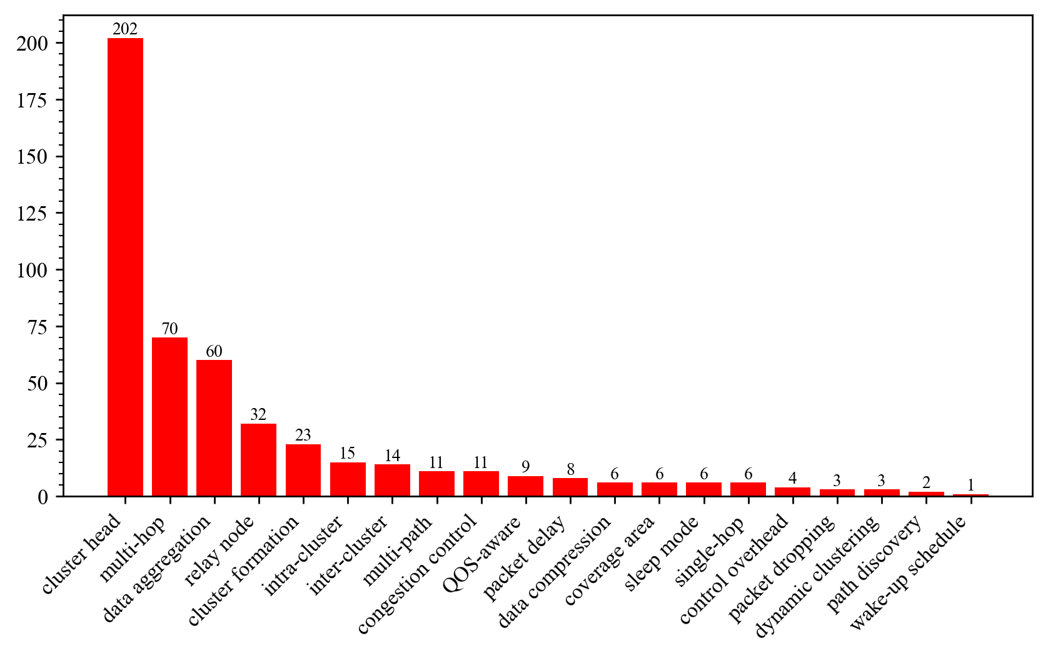
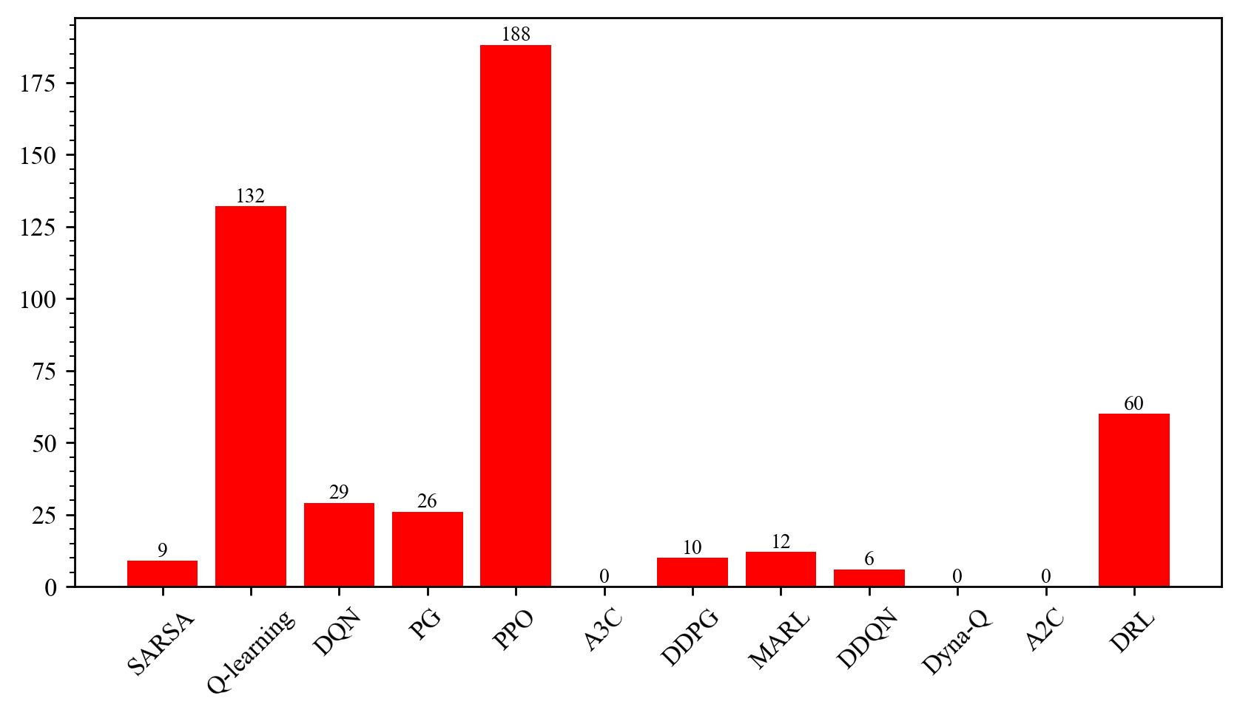
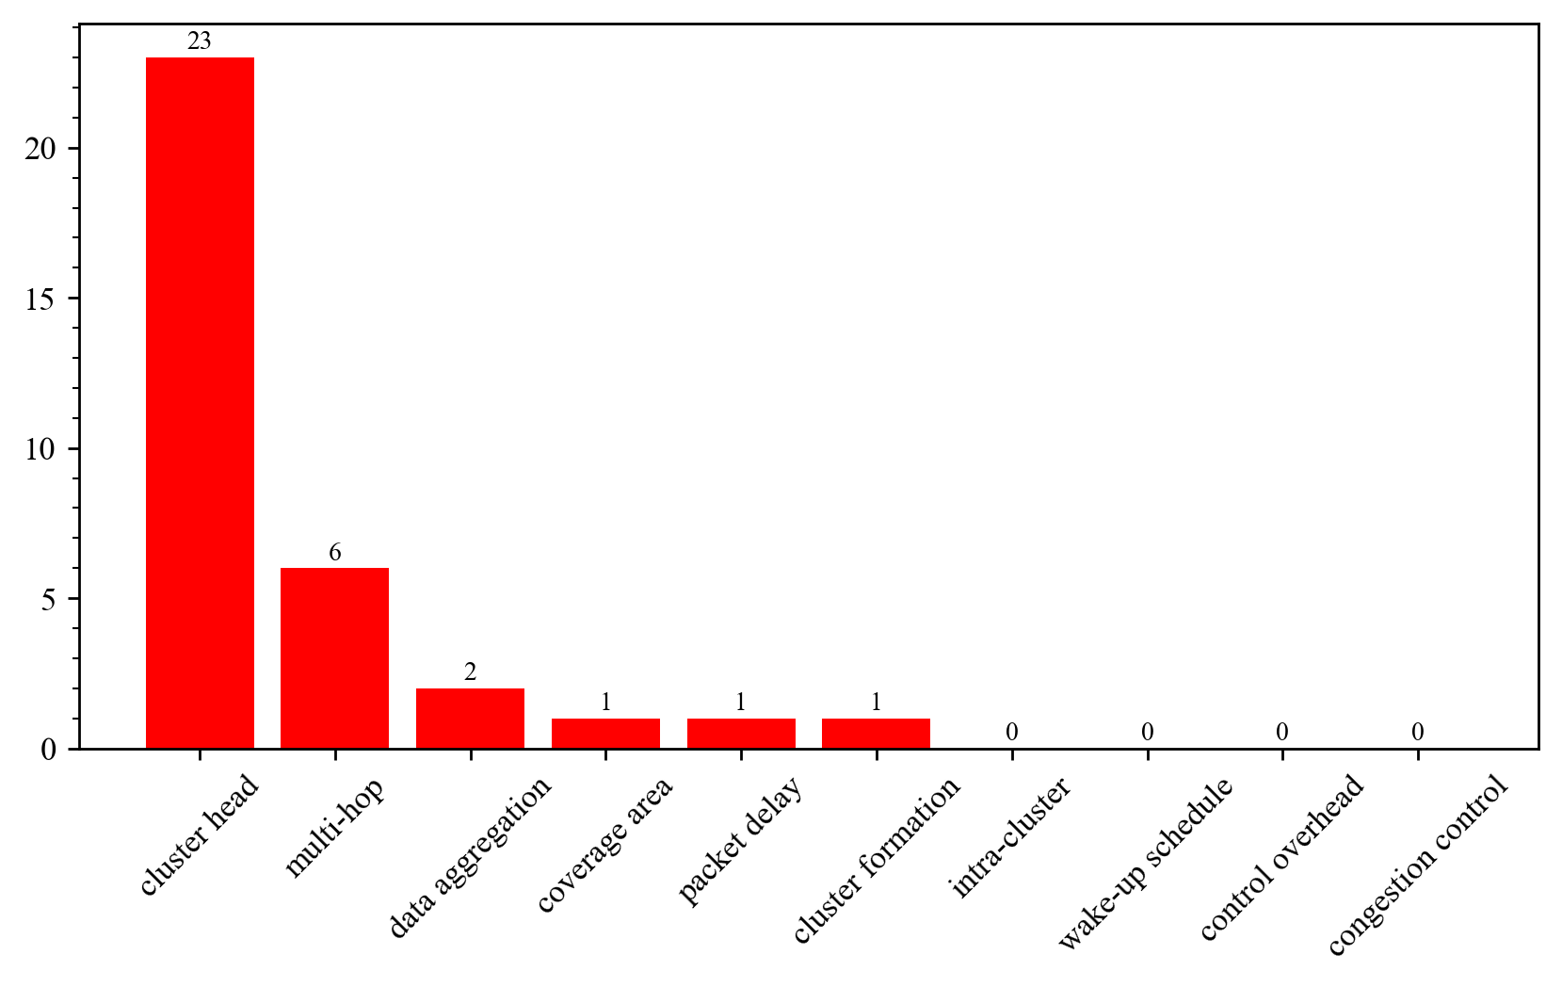
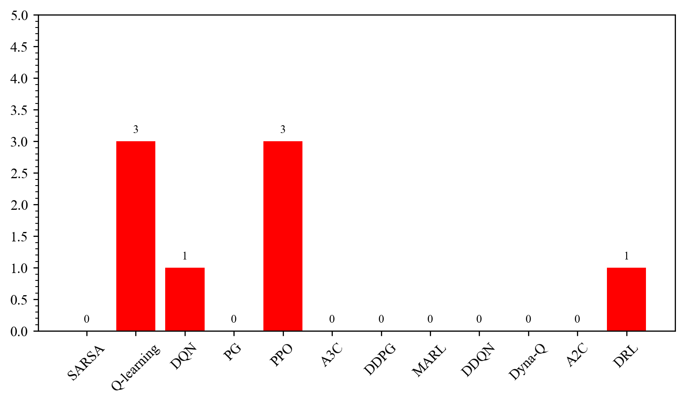
TOPIK PENELITIAN
The most used approach in papers
The most used RL approach in LEACH protocol routing.
There is currently a gap in research regarding the implementation of Deep Q-Network (DQN) algorithms in LEACH protocol .
There is a lack of studies exploring of how DQN can optimize intra-cluster and inter-cluster communication for data aggregation.
There is a lack of studies that explore the application of DQN in the LEACH protocol, especially when compared to other optimization techniques, such as PPO and Q-learning.
The most used metrics in LEACH
The most used RL approach in papers

Slide 18
METODOLOGI
Literature review
Exploring Machine Learning Approaches for Solving Wave Equations: A Review, Trends and Challenges”
Supervised Learning Approach
Deep Neural Networks for Wave Equation Approximation: A Novel Machine Learning Approach
Solving Wave Equations with Supervised Learning: A Convolutional Neural Network Approach ]
Solving Wave Equations with Graph Neural Networks: Modeling Complex Spatial Dependencies
Semi-Supervised Approach
Semi-Supervised Learning for Efficient Wave Equation Modeling: Leveraging Unlabeled Data in Physics-Informed Models
Reinforcement Learning Approach
Reinforcement Learning for Real-Time Adaptation in Solving Wave Equations: A Novel Framework
Study parametric optimization based approach
Optimizing Hyperparameters for Physics-Informed Neural Networks in Wave Equation Solutions Using Gradient-Based Optimization

Slide 19
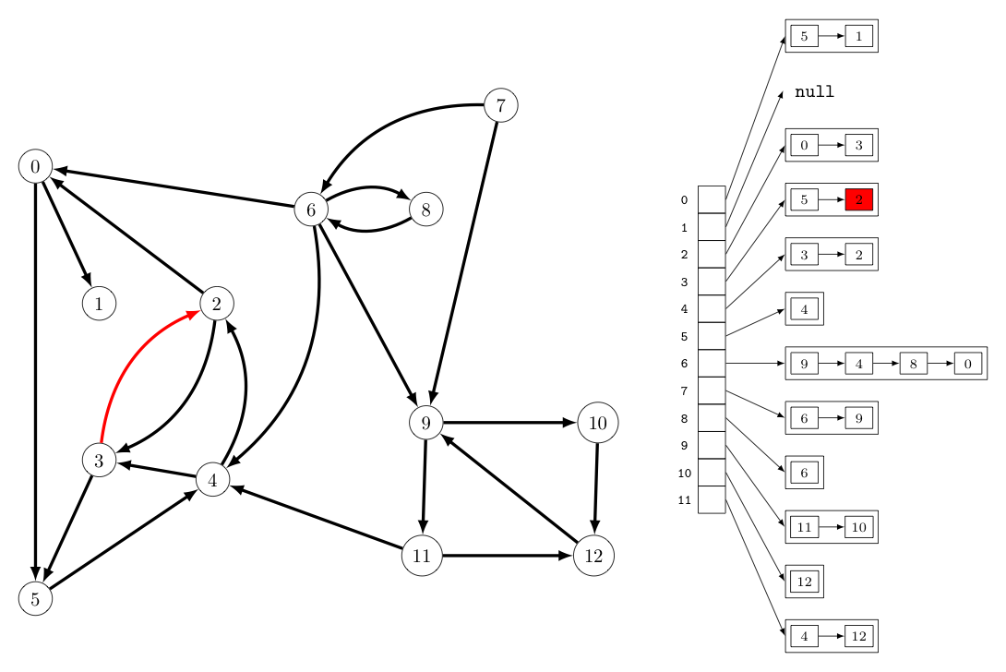
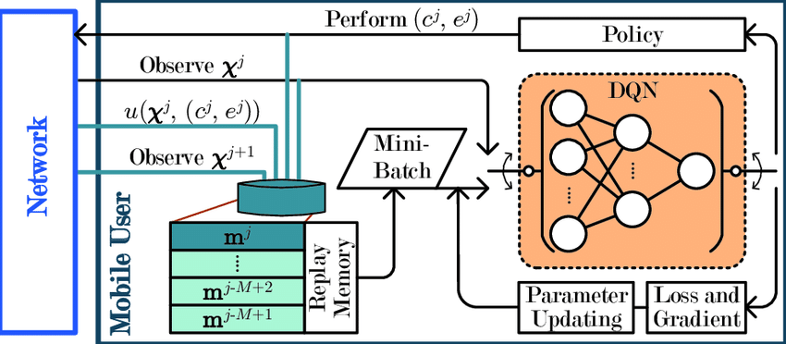
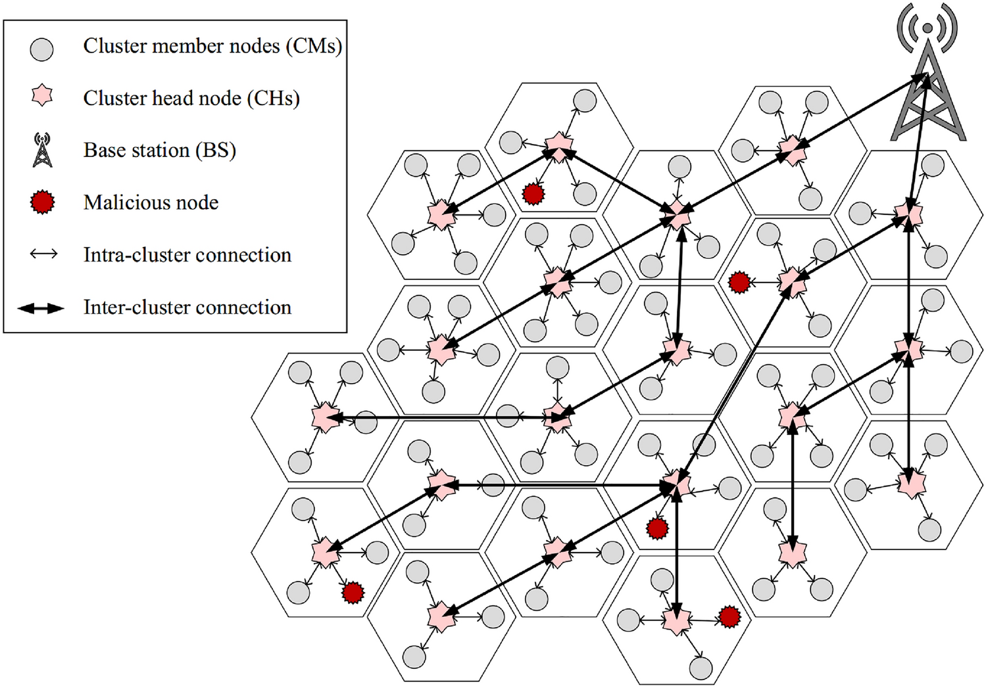
TOPIK PENELITIAN
Deep Reinforcement Learning
Graph Neural Network
Routing Path

Slide 20
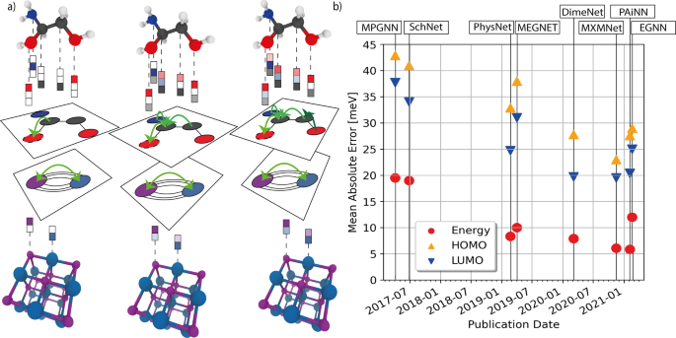
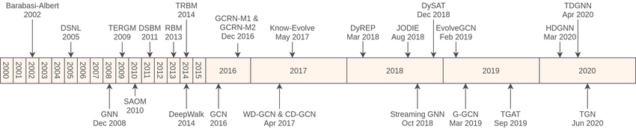
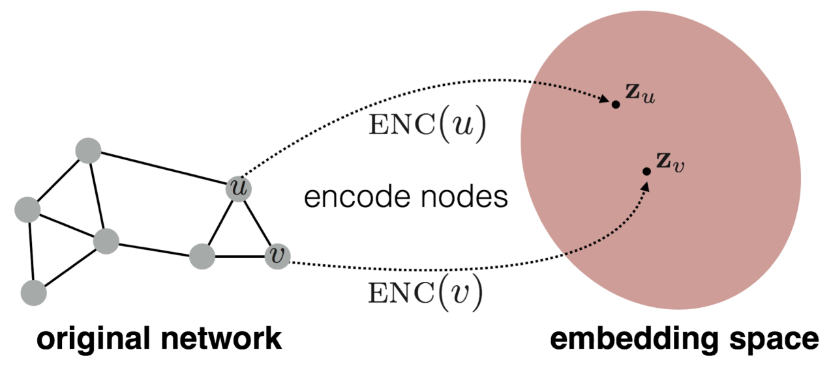
TOPIK PENELITIAN
Initial work used graph theory to represent molecules as graphs, enabling computational chemists to study molecular properties.
Graph Neural Networks (GNNs) with message-passing techniques to efficiently learn node and graph embeddings, enabling applications in various domains like social networks, telecommunication and chemistry.
GNN embeddings can capture complex, high-order dependencies between nodes by iteratively aggregating information from neighbors, allowing for more dynamic representations compare to adjacency matrix.

Slide 21
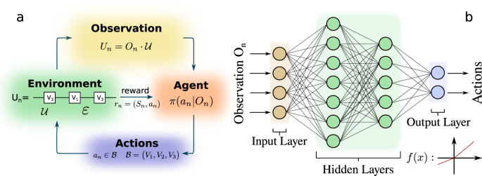
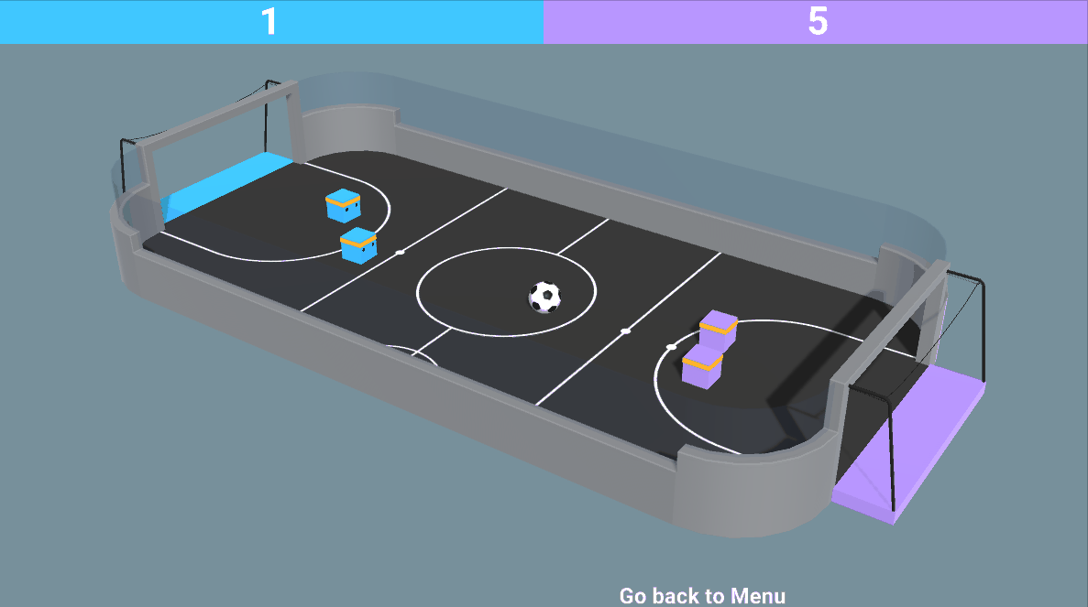
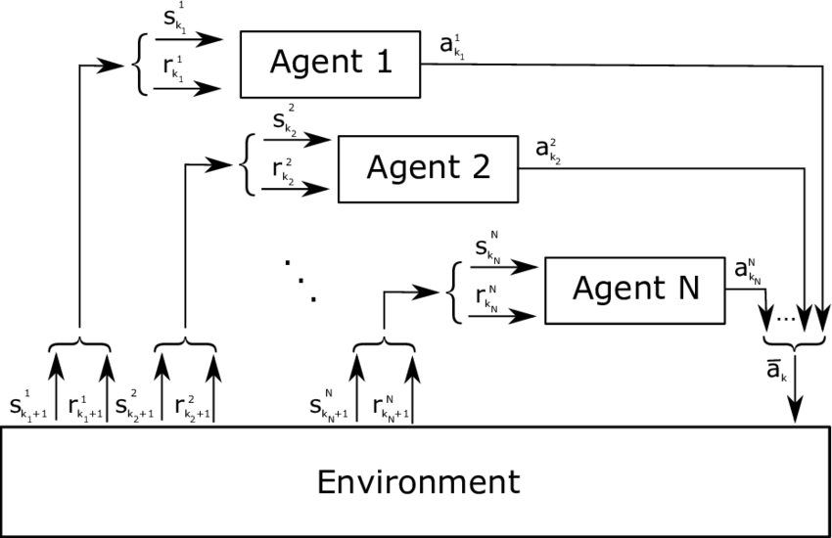
TOPIK PENELITIAN

Slide 22
PHYSIC-INFORMED NEURAL NETWORK
Collecting a large number of data through simulation and then feed it into Neural Network model while adding PDE constraint/condition in architecture

Slide 23
PHYSIC-INFORMED NEURAL NETWORK
Physics-informed graph convolutional neural network for modeling geometry-adaptive steady-state natural convection

Slide 24
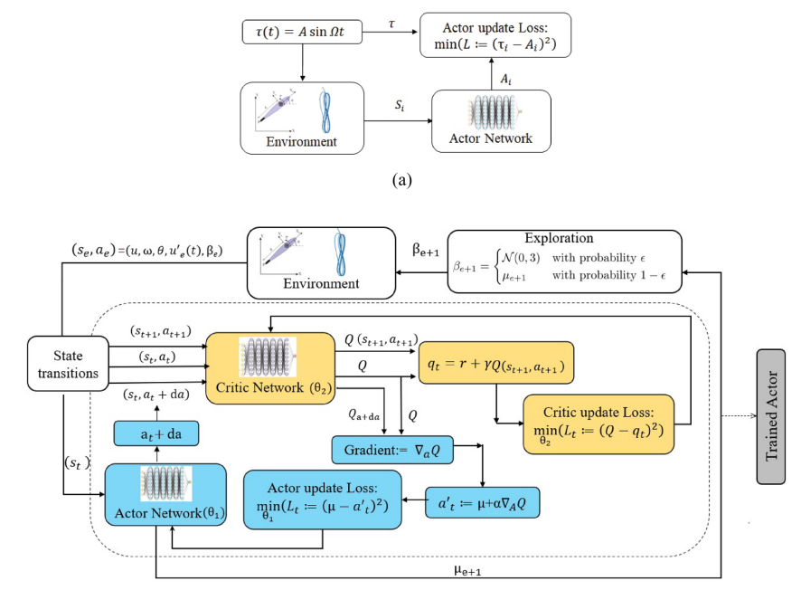
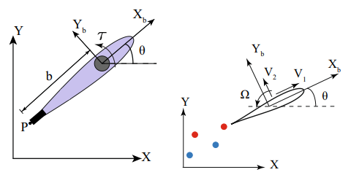
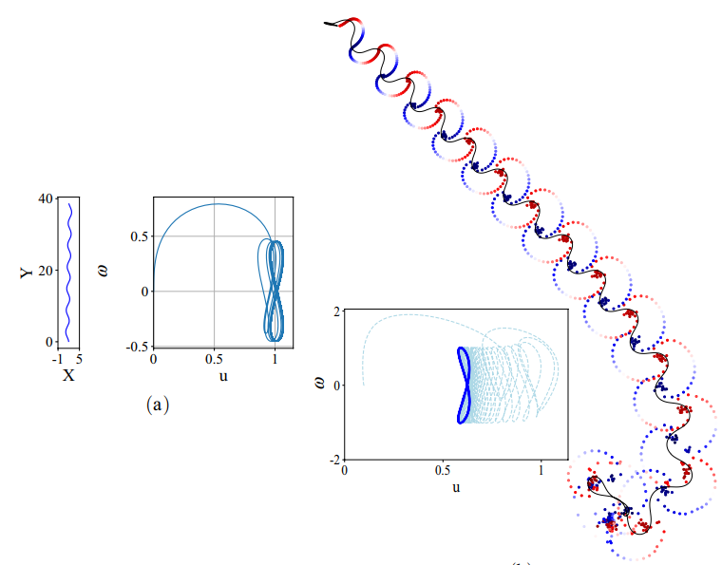
PHYSIC-INFORMED NEURAL NETWORK
Physics‑informed reinforcement learning for motion control of a fsh‑like swimming robot

Slide 25
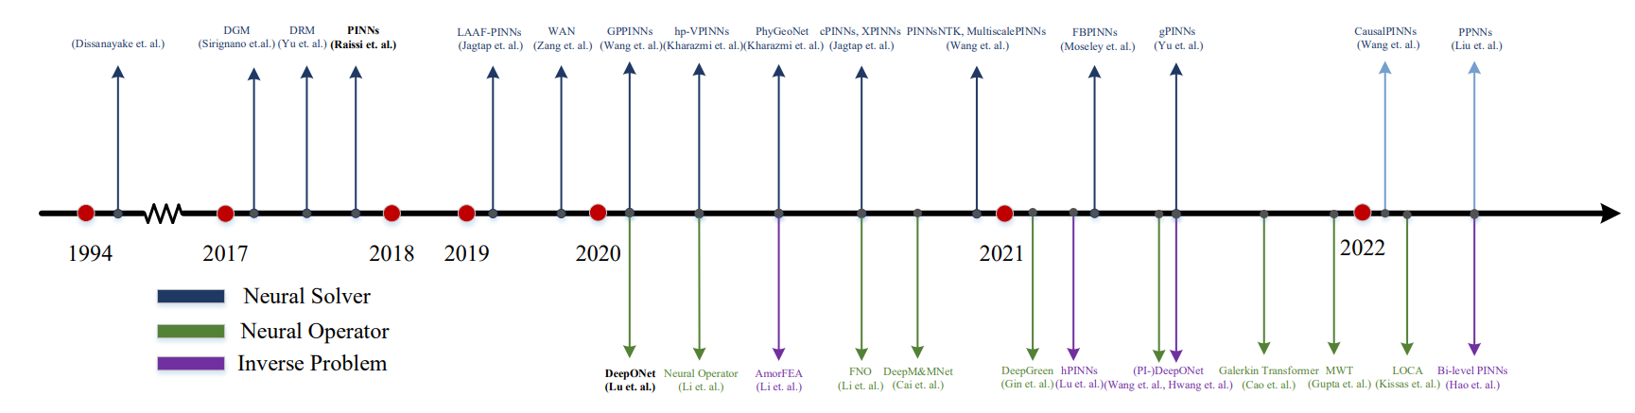
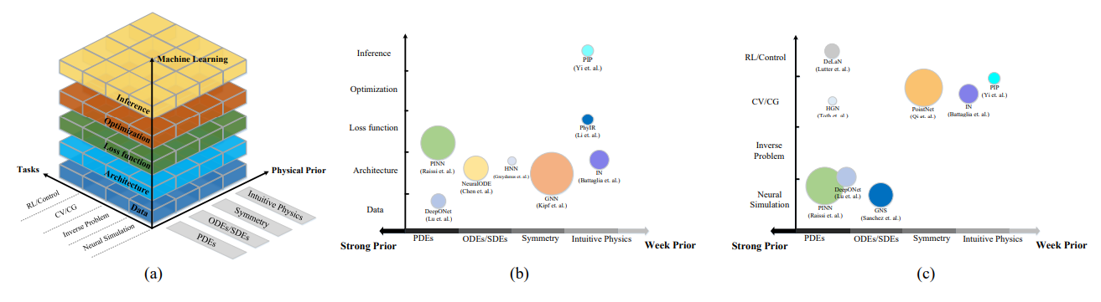
STATE OF THE ART OF PINN

Slide 26
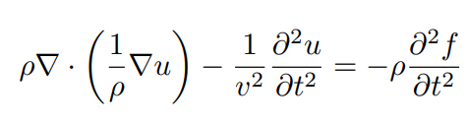
METODOLOGI
Literature review
Exploring Machine Learning Approaches for Solving Wave Equations: A Review, Trends and Challenges”
Supervised Learning Approach
Deep Neural Networks for Wave Equation Approximation: A Novel Machine Learning Approach
Solving Wave Equations with Supervised Learning: A Convolutional Neural Network Approach
Solving Wave Equations with Graph Neural Networks: Modeling Complex Spatial Dependencies
Semi-Supervised Approach
Semi-Supervised Learning for Efficient Wave Equation Modeling: Leveraging Unlabeled Data in Physics-Informed Models
Reinforcement Learning Approach
Reinforcement Learning for Real-Time Adaptation in Solving Wave Equations: A Novel Framework
Study parametric optimization based approach
Optimizing Hyperparameters for Physics-Informed Neural Networks in Wave Equation Solutions Using Gradient-Based Optimization
The focus of this research is on leveraging machine learning techniques to solve the wave equation PDE in wave equation to learn and predict wave behavior under complex boundary conditions, without relying on traditional numerical methods.

